Slide 1
Chapter 14: Data Processing and Control

Slide 2
Objectives
After studying this chapter, students should be able to:
Understand the basic structure of a computer – including main units, buses, and key considerations for computer system design.
Master the microprocessor – its components, architecture, operation, and addressing modes.
Explain important concepts – such as DMA, buffers, decoders, interrupts, polling, and bus requests.
Explore the operating system and system performance – including pipelining, multitasking, and multiprocessing.
Get familiar with machine and assembly languages – write simple programs and distinguish between them

Slide 3
Contents
14.1. The Computer System 14.2. Practical Computer System Considerations 14.3. The Processor: Basic Operation 14.4. The Processor: Addressing Modes 14.5. The Processor: Special Operations 14.6. Operating Systems and Hardware 14.7. Programming 14.8. Microcontrollers and Embedded Systems 14.9. System on Chip (SoC)

Slide 4
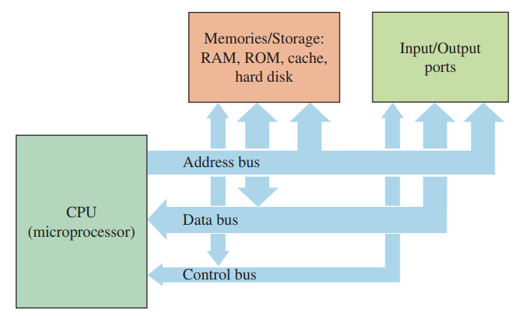
14.1. The Computer System
Computer Systems: Core Functions and Components Each component in the system plays a role in these tasks – as shown in the block diagram.

Slide 5
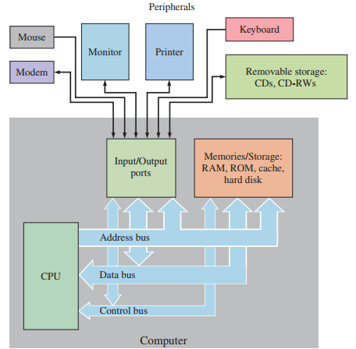
14.1. The Computer System
A Typical Computer System

Slide 6
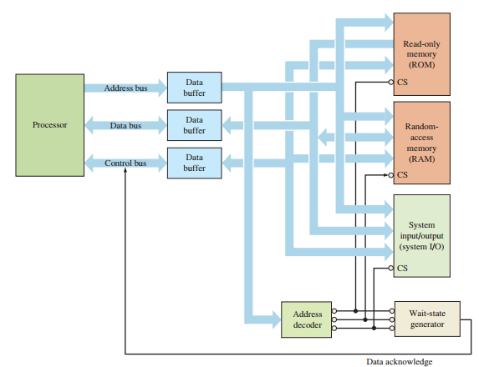
14.2. Practical Computer System Considerations
Shared Signal Lines

Slide 7
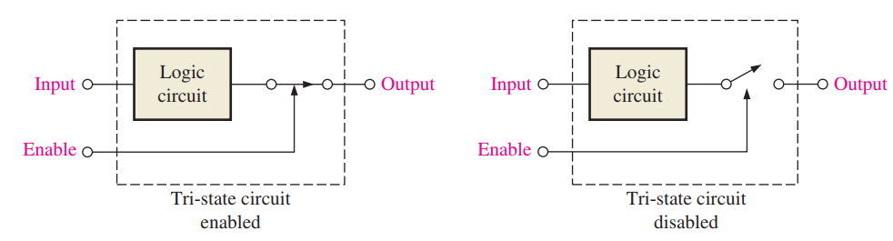
14.2. Practical Computer System Considerations
Tri-State Outputs in Digital Systems A tri-state switch disconnects the device from the signal line in High-Z mode.
Prevents signal interference when multiple devices share the same bus.
Only one device should drive the bus at a time to avoid bus contention.

Slide 8
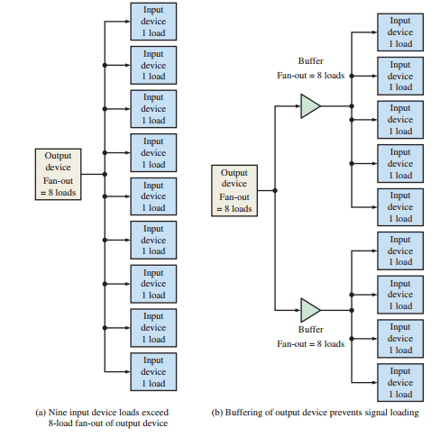
14.2. Practical Computer System Considerations
Signal Loading and Buffering The issue of inputs affecting the performance of an output to which they are connected is called signal loading.

Slide 9
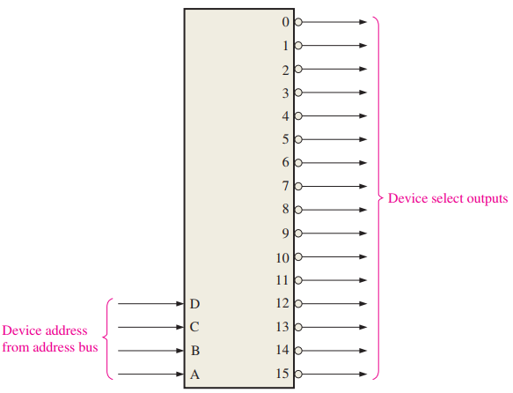
14.2. Practical Computer System Considerations
Device Selection
The processor uses the address bus to access devices such as ROM, RAM, and I/O.
Each device has a special pin called chip select (CS) or chip enable (CE) to determine when it is activated.
It is not practical for the processor to have a separate control line for each device ⇒ decoders or PLDs are used to generate device select signals.

Slide 10
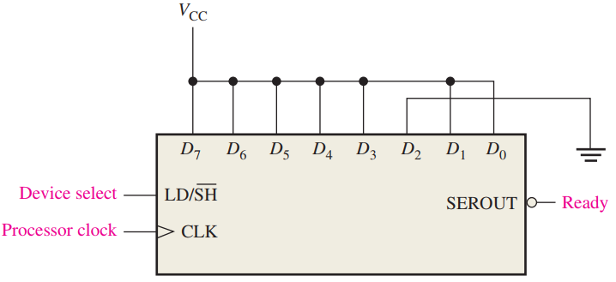
14.2. Practical Computer System Considerations
System Timing System timing ensures the processor meets the setup/hold times of peripherals using synchronous, asynchronous, or semisynchronous buses. Wait states may be added to slow down the processor when peripherals cannot keep up with its speed.

Slide 11
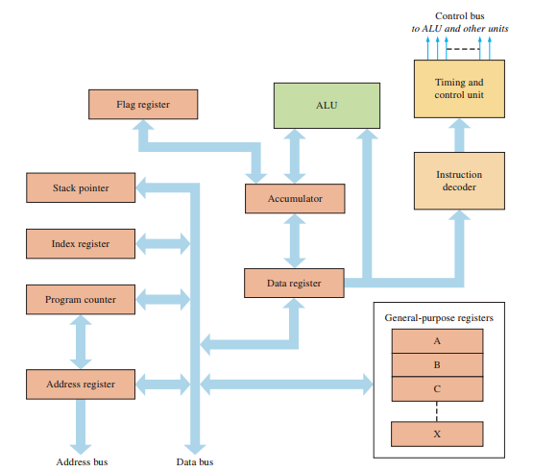
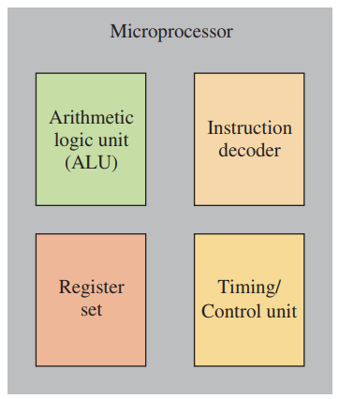

14.3. The Processor: Basic Operation
Microprocessor (CPU) The four basic elements that are common to all microprocessors are the arithmetic logic unit (ALU), the instruction decoder, the register set, and the timing and control unit.

Slide 12
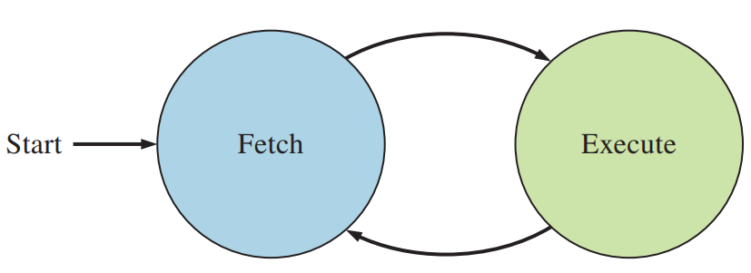

14.3. The Processor: Basic Operation
The Fetch/Execute Cycle When a program is being run, the processor goes through a repetitive cycle consisting of two fundamental phases.

Slide 13
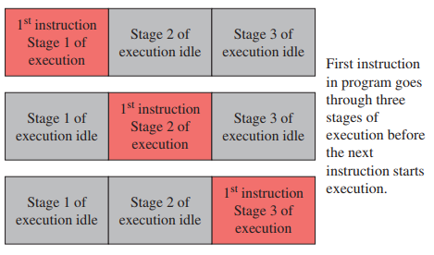
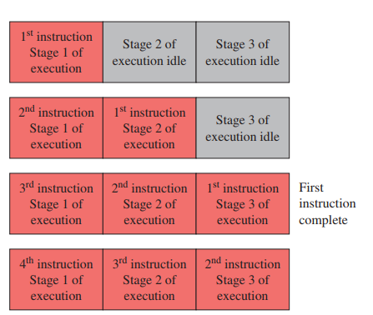
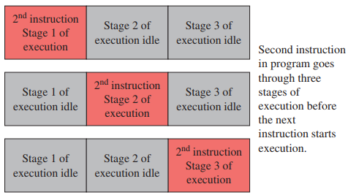
14.3. The Processor: Basic Operation
Pipelining A technique where the microprocessor begins executing the next instruction in a program before the previous instruction has been completed is called pipelining.

Slide 14
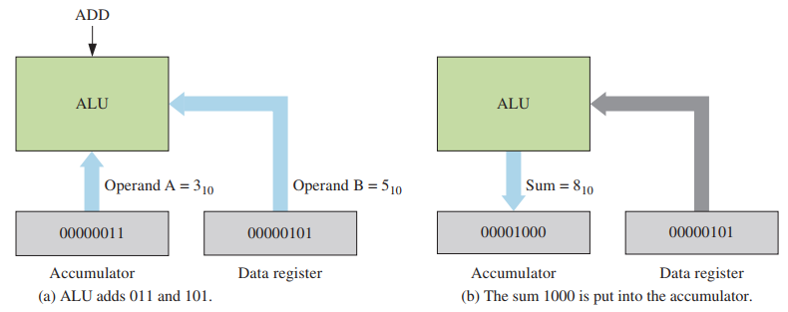
14.3. The Processor: Basic Operation
Processor Elements This part of the processor contains the logic to perform arithmetic and logic operations. Data are transferred into the ALU from the accumulator and from the data register.

Slide 15
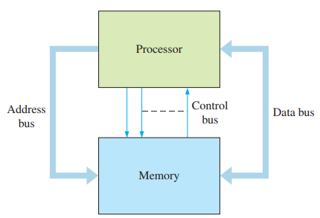
14.3. The Processor: Basic Operation
The Processor and the Memory The processor is connected to a memory with the address bus and data bus. Also, there are certain control signals that must be sent between the processor and the memory, such as the read and write controls.

Slide 16
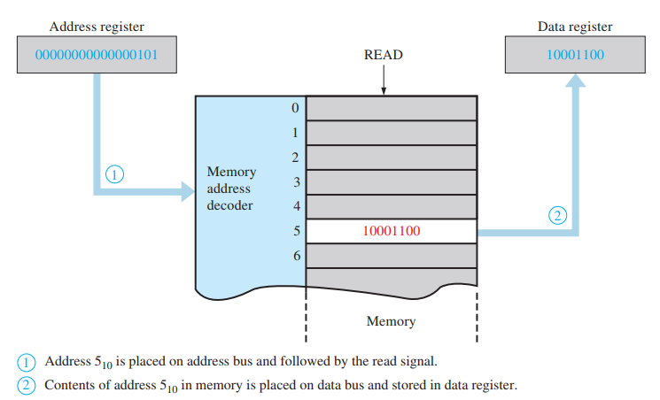
14.3. The Processor: Basic Operation
The Read Operation

Slide 17
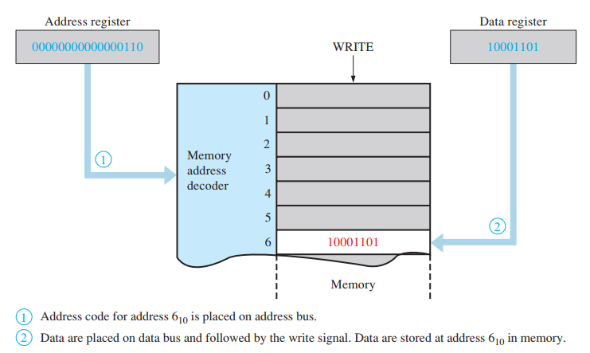
14.3. The Processor: Basic Operation
The Write Operation

Slide 18
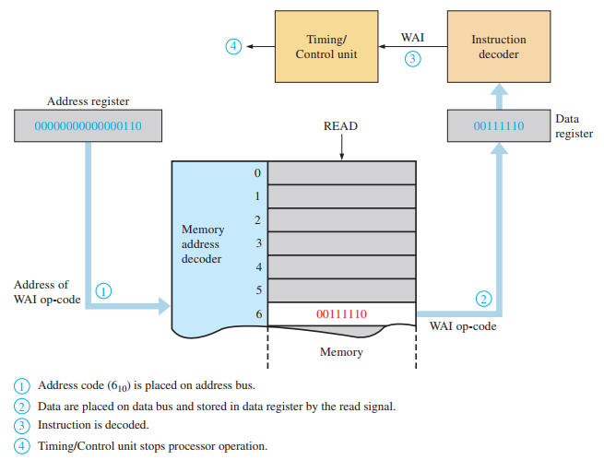
14.4.The Processor: Addressing Modes
Inherent Addressing

Slide 19
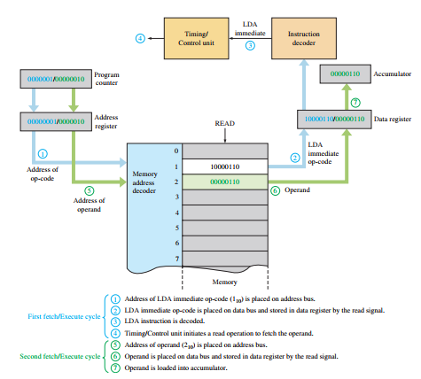
14.4.The Processor: Addressing Modes
Immediate Addressing

Slide 20
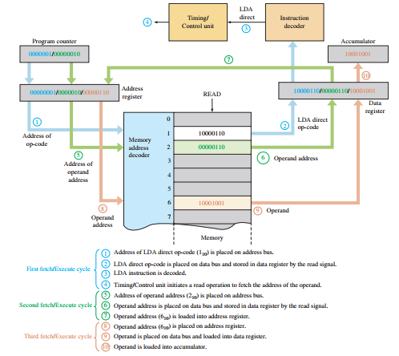
14.4.The Processor: Addressing Modes
Direct Addressing

Slide 21
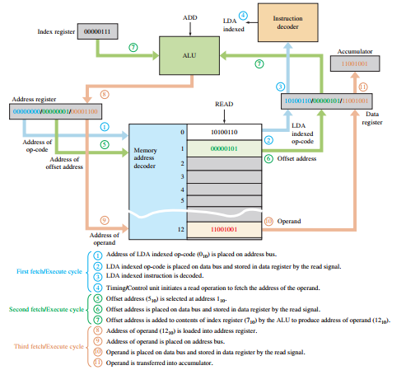

14.4.The Processor: Addressing Modes
Indexed Addressing

Slide 22
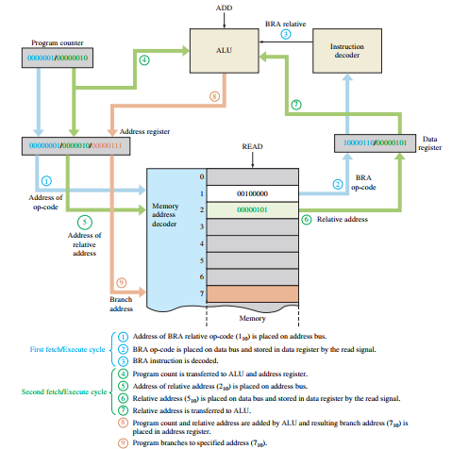
14.4.The Processor: Addressing Modes
Relative Addressing

Slide 23
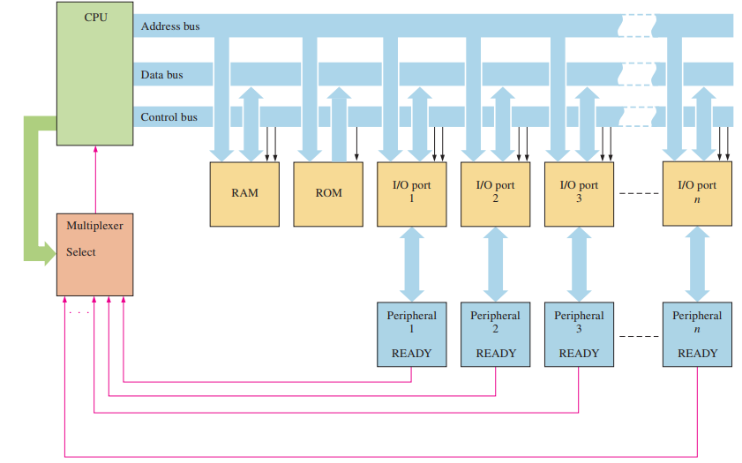
14.5. The Processor: Special Operations
Polling

Slide 24
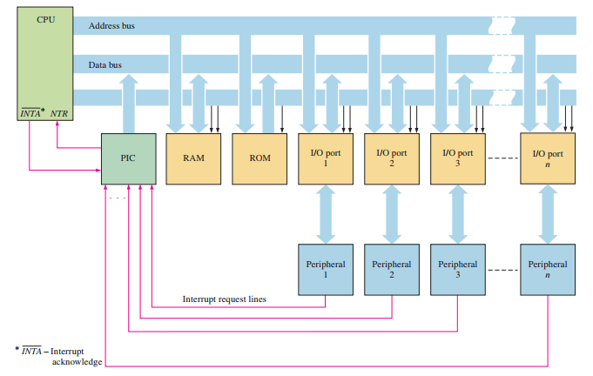
14.5. The Processor: Special Operations
Interrupts and Exceptions

Slide 25
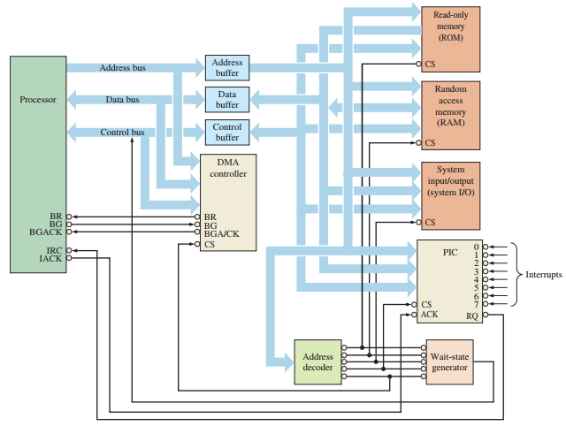
14.5. The Processor: Special Operations
Direct Memory Access (DMA)

Slide 26
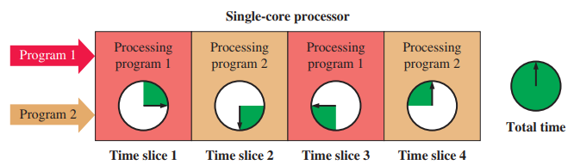
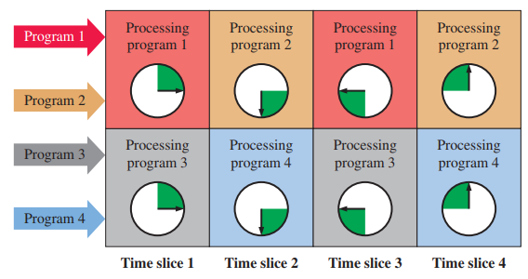
14.6. Operating Systems and Hardware
Multiple Processes

Slide 27
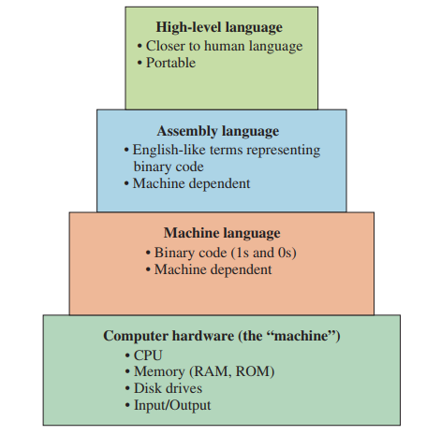
14.7. Programming
Levels of Programming Languages

Slide 28
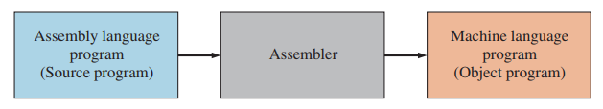
14.7. Programming
Assemblers An assembler translates and converts a program written in assembly language into machine code.

Slide 29
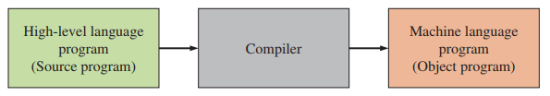
14.7. Programming
Compilers A compiler is a program that compiles or translates a program written in a high-level language and converts it into machine code.

Slide 30
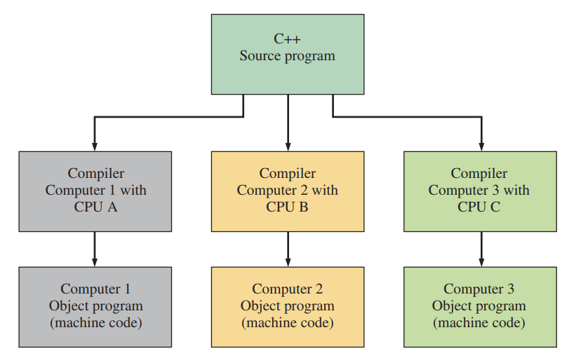
14.7. Programming
Compilers All high-level languages, such as C++, will run on any computer. A given high-level language is valid for any computer, but the compiler that goes with it is specific to a particular type of CPU.

Slide 31
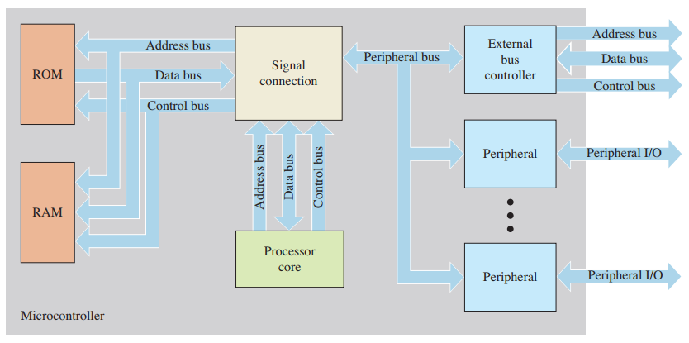
14.8. Microcontrollers and Embedded Systems
Microcontroller Basics

Slide 32
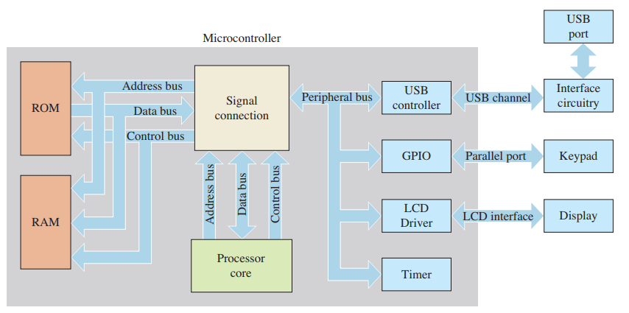
14.8. Microcontrollers and Embedded Systems
Microcontrollers in Embedded Systems

Slide 33
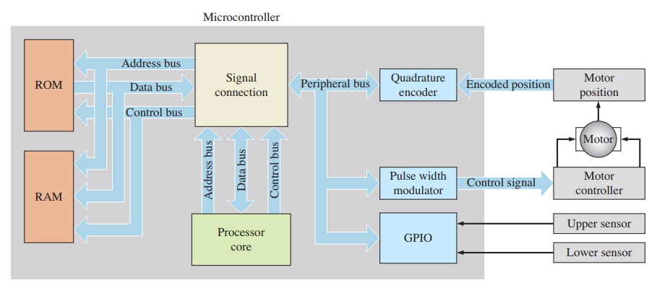
14.8. Microcontrollers and Embedded Systems
Automated Systems

Slide 34
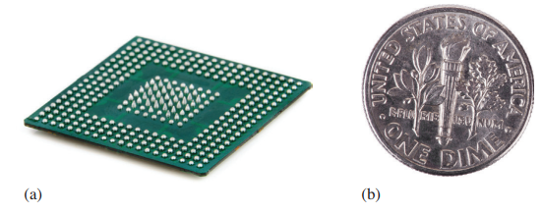
14.9. System on Chip (SoC)
System on chip (SoC) A system on chip (SoC) is an integrated circuit that combines all components of a computer or other electronic system on a single chip. The SoC offers reduced manufacturing costs and smaller system configurations; Package sizes can be smaller than a dime.

Slide 35
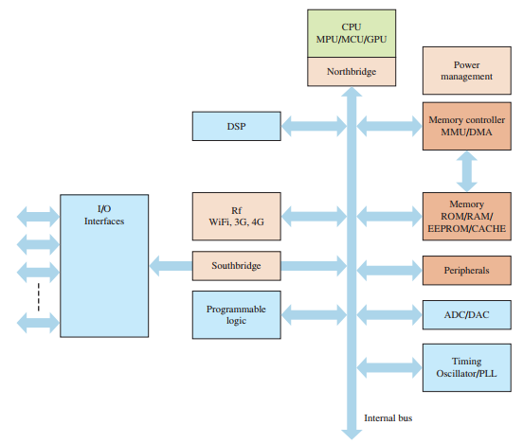
14.9. System on Chip (SoC)
Generic block diagram of a typical SoC

Slide 36
SUMMARY
Chapter 14: Data Processing and Control
The CPU has four main components: ALU, registers, control unit, and instruction decoder.
A computer performs three main tasks: input, process, and output data.
Different types of memory are used for specialized functions (e.g., cache).
Pipelining, multitasking, and multiprocessing improve processing performance.
Microcontrollers are suitable for embedded systems and real-time processing.

Slide 37
MULTIPLE-CHOICE TEST AND PROBLEMS
Complete the true/false questions, multiple-choice questions, and end-of-chapter exercises in the primary textbook.

